Slide 1

Revenue Recognition Part 2 - Video

Slide 2
Misc. Revenue Topics
Unexecuted Contracts
Sales Returns
Principal Agent Relationships

Slide 3
Misc. Revenue Topics
Unexecuted Contracts
Sales Returns
Principal Agent Relationships

Slide 4
1) Unexecuted contracts:
 |  | Cash
 |  | Received | Not Received
Revenue | Earned | Dr. Cash (B-A) Cr. Revenue (I-R) | Dr. Accounts receivable (B-A) Cr. Revenue (I-R)
 | Not Earned | Dr. Cash (B-A) Cr. Unearned revenue (B-L) | ???

Slide 5
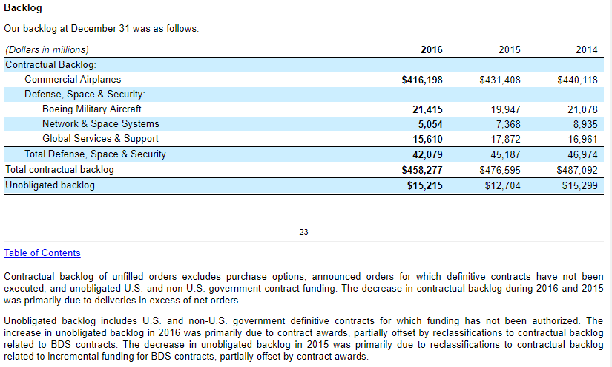
1) Unexecuted contracts:
Boeing example
Notes:
Boeing has 416 billion in contracts signed, but no cash received and no planes delivered
This is useful information to investors
But accounting says you can’t recognize it, but rather you disclose

Slide 6
Misc. Revenue Topics
Unexecuted Contracts
Sales Returns
Principal Agent Relationships

Slide 7
2) Sales and Returns
If it is likely that some customers will return products, then revenue should reflect the expected after-return amount.
1) Reduce revenue at the time of sale for expected returns and create a liability
Cash (B-A) 1,000
Revenue (I-R) 900
Return Liability (B-L) 100
2) Record COGS reduced for returns, asset for inventory expected returned
COGS (I-E) 450
Estimated Inv. Returns (B-A) 50
Inventory (B-A) 500
3) When returns occur, reverse (and correct if necessary)
Return Liability (B-L) 100
Cash (B-A) 100
Inventory (B-A) 50
Estimated Inv. Returns (B-A) 50

Slide 8
Misc. Revenue Topics
Unexecuted Contracts
Sales Returns
Principal Agent Relationships

Slide 9
3) Principal-Agent (“Middleman”)
Priceline.com acts as a broker to sell a United Airlines ticket for $300 plus $10 commission
For Priceline - (Jan 1):
Cash (B-A) $310
Sales Revenue (I-R) $10
A/P(B-L) $300

Slide 10
3) Principal-Agent (“Middleman”)
Priceline.com acts as a broker to sell a United Airlines ticket for $300 plus $10 commission
For United Airlines - Initial date (Jan 1):
Receivable (B-A) $300
Commission Expense (I-E) $10
Sales Revenue (I-R) $310

Slide 11
3) Principal-Agent (“Middleman”)
Same for physical goods – a congsignor gives goods to a consignee to sell.
No entry at initial transfer of goods.
Recognize revenues and expenses similar to priceline/UA example

Slide 12
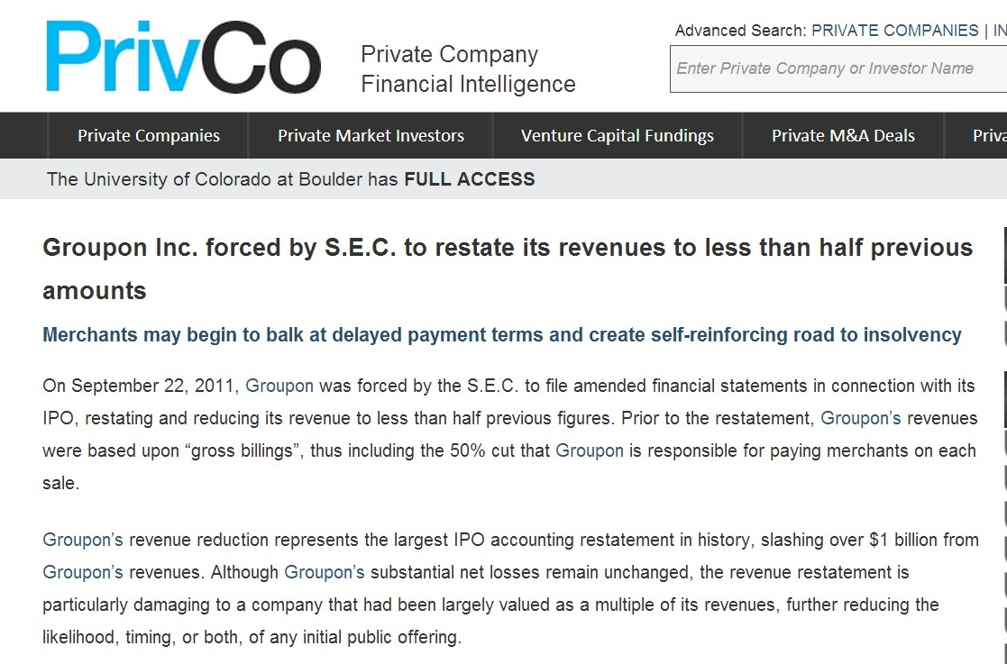

Slide 13
Closing Thoughts
Disclose unexecuted contracts
Recognize estimated post-return revenue up front, liability for cash to be returned and asset for inventory to be returned
If you are an agent, recognize net revenue you keep. If you are principal, full revenue and commission expense.

Slide 14
Revenue Recognition Part 2 - Video

